Slide 1
Hard Disk Drive

Slide 2
A hard disk is also known as a hard drive or fixed disk.
It is said to be rigid magnetic disc that stores data.
It is located within a drive unit.
Hard disk is a non-volatile storage device that contains platters and magnetic disks rotating at high speeds.
Non-volatile means the data retains when the computer shuts down.

Slide 3
It is installed internally in our computer systems.
Hard disk is located within a drive unit on the computer's motherboard and comprises one or more platters packed in an air-sealed casing.
Its main components include a read/write actuator arm, head actuator, read/write head, spindle, and platter.
A circuit board (also called as the interface board or disk controller) is present on the back of a hard drive.
It lets the hard drive to communicate with the computer.

Slide 4
Function of Hard disk
The hard disk is a secondary storage device, which is designed to store data permanently.
The secondary storage devices include a large storage capacity as compared to the primary storage devices.
The data stored in a hard disk is retained when our computer system shuts down.
The data stored in the hard disk can be of many types such as the operating system, installed software, documents, and other files of computer.

Slide 5
Hard disk was introduced in the year 1956 by IBM.
The first personal computer contains a hard drive of less than 1 megabyte, while modern computers contain a hard drive of 1 terabyte.

Slide 6
Every computer contains at least one hard drive to store data and software. In Windows operating system, the hard drive is known to be the C drive, and in MAC, it is simply called as the hard drive.
The desktop computers which have external hard drives are used for backup purposes or additional storage.

Slide 7
The size of hard drives is measured in gigabytes and terabytes.
Usually, 500GB hard disks are common in modern computers. As an instance, a song of length four-minute is approx.
4MB in size, and in 1 gigabyte, there are 1,000 megabytes, it means that a 500GB hard drive can store approx. 250,000 songs.

Slide 8
Advantages of the hard disk
The advantages of a Hard Disk Drive are given as follows:
One of the significant advantages of a Hard Disk drive is that its cost is low.
Another advantage of a Hard Disk is that it is readily available in the market.
Hard Disk is faster than optical disks.
The capacity for storing the data in HDDs is large.

Slide 9
Disadvantages of the hard disk
The speed of reading and writing in HDD is slower than the RAM.
HDDs are noisy.
Another disadvantage of HDD is energy inefficiency.
HDDs consume more power.

Slide 10
Hard Disk Drive is installed internally in our computer systems, which is connected directly to the disk controllers of the motherboard. Hard Disk Drive is a storage device which stores the operation system (OS) , installed software, and the other computer files.

Slide 11
HDD means the data is retained when our computer system is shut down. HDD is also called a fixed disk, hard disk, or hard drive. The HDD was introduced in the year 1956 by IBM.

Slide 12
The first personal computer contains a hard drive of less than 1 megabyte, while modern computers contain the hard drive of 1 terabyte.
The desktop computers which have external hard drives are used for backup purposes or additional storage.

Slide 13
Physical Structure of HDD

Slide 14
A hard disk consists of a stack of disk platters that are made up of aluminum alloy of glass coated with a magnetic material
most hard disks have from two to eight platters.
Each side of each platter has a read/write head that floats over the surface of the rapidly spinning disk and picks up (reads) magnetically stored data, or records (writes) data onto the disk.

Slide 15
In a hard disk, the head doesn’t touch the disk surface.
Instead, the read/write heads float on an extraordinarily thin cushion of air, about the height of a fingerprint.

Slide 16
The surface of a disk is divided into imaginary tracks and sectors. Tracks are concentric circles where the data is stored.
These tracks are numbered from the outermost ring to the innermost ring, starting from zero.
Disk sectors refer to the number of fixed size areas that can be accessed by one of the disk drive’s read/write heads, in one rotation of the disk, without the head having to change its position.
An intersection of a track and a disk sector is known as track sector.

Slide 17
Each sector is uniquely assigned a disk address before a disk drive can access a piece of data.
In order to make the disk usable, first it must be formatted to create tracks and sectors.
The track sectors are grouped into a collection known as cluster. It refers to the basic allocation unit for storage on a disk.

Slide 18
On the hard disk we will keep the operating system, and copies of all the software applications you use, such as your word processor and your spreadsheet program, plus copies of all the documents or files we create.

Slide 19
Hard disk Components

Slide 20
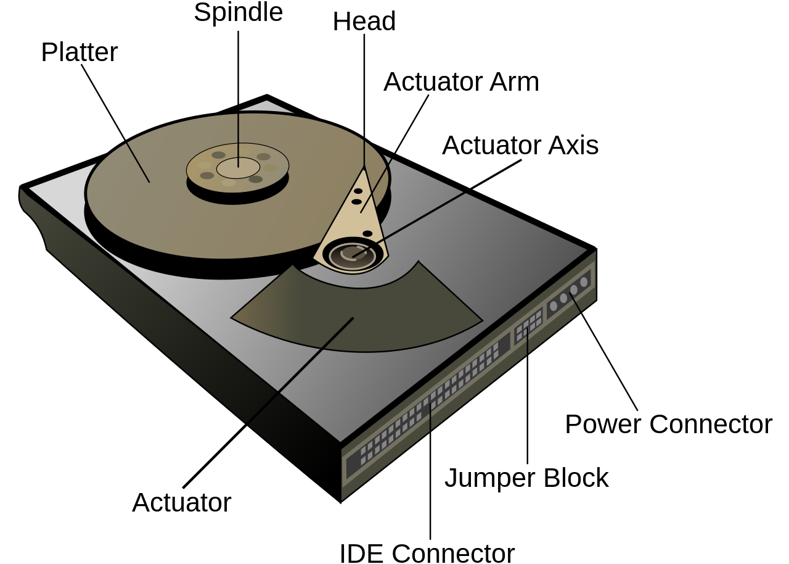

Slide 21
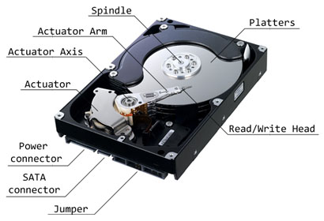

Slide 22
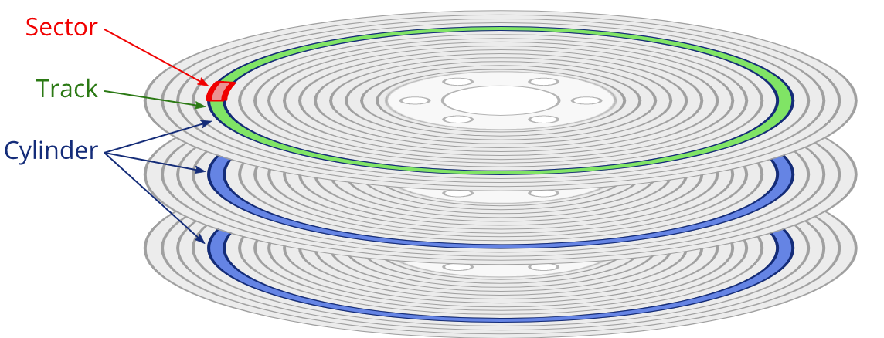

Slide 23
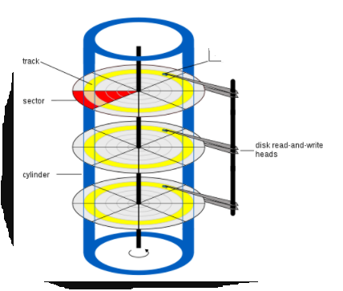

Slide 24
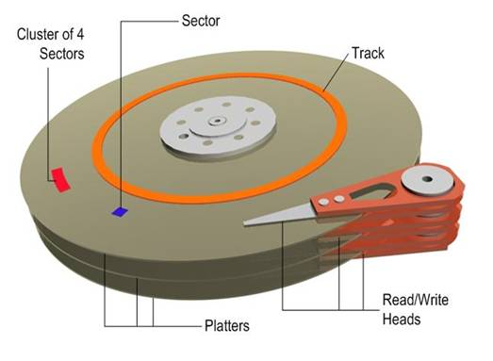

Slide 25
